Slide 1

Defining Classes
Classes, Fields, Constructors, Methods
SoftUni Team
Technical Trainers
Software University
https://softuni.bg

Slide 2

Table of Contents
Defining Simple Classes
Fields
Methods
Constructors, Keyword this
Static Members

Slide 3
Have a Question?
sli.do
#java-advanced

Slide 4

Defining Classes

Slide 5
Defining Simple Classes
Specification of a given type of objects from the real-world
Classes provide structure for describing and creating objects
Class name
Keyword
class Car {
…
}
Class body
5

Slide 6


Naming Classes
Use PascalCase naming
Use descriptive nouns
Avoid ambiguous names
class Dice { … }
class BankAccount { … }
class IntegerCalculator { … }
class TPMF { … }
class bankaccount { … }
class numcalc { … }
6

Slide 7
Class Members
Class is made up of state and behavior
Fields store state
Methods describe behaviour
class Car {
String brand;
String model;
void start(){ … }
}
class Dog {
int age;
String type;
void bark(){ … }
}
Fields
Fields
Method
Method
7

Slide 8

Creating an Object
A class can have many instances (objects)
class Program {
public static void main() {
Car firstCar = new Car();
Car secondCar = new Car();
}
}
Variable stores a reference
Use the new keyword
8

Slide 9
Object Reference
Declaring a variable creates a reference in the stack
The new keyword allocates memory on the heap
Car car = new Car();
STACK
HEAP
obj
diceD6
(1540e19d)
type = null
sides = 0
9

Slide 10
Classes vs. Objects
Classes provide structure for creating objects
An object is a single instance of a class
class
Dice
object D6Dice
Object name
Class name
sides: int
sides = 6
Class fields
Object data
roll(…)
Class actions (methods)
10

Slide 11

Class Data

Slide 12
Fields
Class fields have access modifiers, type and name
public class Car {
private String brand;
private int year;
public Person owner;
…
}
type
access modifier
name
Fields can be of any type
12

Slide 13
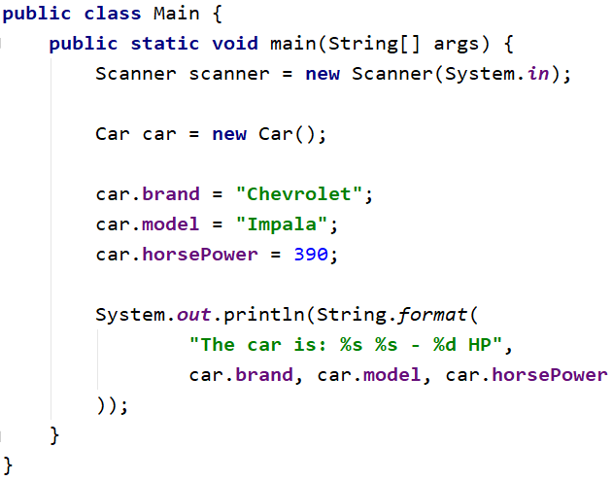
Problem: Define Car Class
Create a class Car
Ensure proper naming!
Class name
Car
Class fields
+brand:String
+model:String
+horsePower:int
Class methods
(no actions)

Slide 14
Solution: Define Car Class
public class Car {
String brand;
String model;
int horsePower;
}

Slide 15
Access Modifiers
Classes and class members have modifiers
Modifiers define visibility
Class modifier
public class Car {
private String brand;
private String model;
}
Fields should always be private!
Member modifier

Slide 16

Methods

Slide 17
Methods
Store executable code (algorithm) that manipulate state
class Car {
private int horsePower;
public void increaseHP(int value) {
horsePower += value;
}
}

Slide 18
Getters and Setters
Used to create accessors and mutators (getters and setters)
class Car {
private int horsePower;
public int getHorsePower() {
return this.horsePower;
}
public void setHorsePower(int horsePower) {
this.horsePower = horsePower;
}
}
Field is hidden
Getter provides access to field
this points to the current instance
Setter provide field change

Slide 19
Getters and Setters
Keyword this
Prevent field hiding
Refers to a current object
private int horsePower;
public void setSides(int horsePower) {
this.horsePower = horsePower;
}
public void setSidesNotWorking(int horsePower) {
horsePower = horsePower;
}

Slide 20
ToString() Method
We can use toString() method to get String representation of an object.
Whenever we try to print the Object reference then internally toString() method is invoked.
If we did not define toString() method in your class then Object class toString()
Car car = new Car();
System.out.println(car); //Car@3feba861
20

Slide 21
ToString() Method
If you define toString() method in your class then your implemented/Overridden toString() method will be called..
public class Car {
…
@Override
public String toString() {
return this.brand + ":" + this.model;
}
}
Car car = new Car();
System.out.println(car); //BMW:M3
21

Slide 22
Equals() Method
In java equals() method is used to compare equality of two Objects
Car firstCar = new Car("BMW","M3");
Car secondCar = new Car("Mercedes","C63 AMG");
boolean isEqual = firstCar.equals(secondCar);
System.out.println(isEqual); //false
22

Slide 23
HashCode() Method
Method returns the hash code for the Method class object.
The hash code is always the same if the object doesn’t change.
Syntax:
Car car = new Car();
int hash = car.hashCode(); //integer value which represents hashCode value for this class.
System.out.println(hash); //1072408673
23

Slide 24
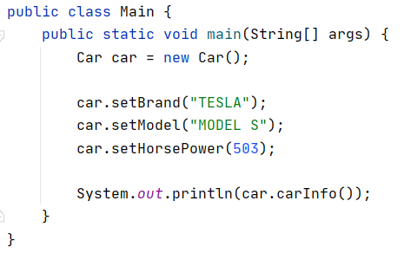
Problem: Car Info
Create a class Car
- == private
Car
-brand:String
…
return type
+setBrand():void
+getBrand():String
…
+carInfo():String
+ == public
Check your solution here: https://judge.softuni.bg/Contests/1517/Defining-Classes-Lab

Slide 25
Solution: Car Info
public class Car {
private String brand;
private String model;
private int horsePower;
public void setBrand(String brand) { this.brand = brand; }
public String getBrand() { return this.brand; }
public String carInfo() {
return String.format("The car is: %s %s - %d HP.",
this.brand, this.model, this.horsePower);
}
//TODO: Create the other Getters and Setters
}
//TODO: Test the program
Check your solution here: https://judge.softuni.bg/Contests/1517/Defining-Classes-Lab

Slide 26

Constructors

Slide 27
Constructors
Special methods, executed during object creation
The only one way to call a constructor in Java is through the keyword new
public class Car {
private String brand;
public Car() {
this.brand = "BMW";
}
}
Overloading default constructor
27

Slide 28
Constructors (1)
Special methods, executed during object creation
class Car {
private String brand;
…
public Car() {
this.brand = "unknown";
…
}
}
Overloading default constructor

Slide 29
Constructors (2)
You can have multiple constructors in the same class
public class Car {
private int horsePower; private String brand;
public Car(String brand) {
this.brand = brand;
}
public Car(String brand, int horsePower) {
this.brand = brand;
this.horsePower = horsePower;
}
}
Constructor with one parameter
Constructor with all parameters

Slide 30
Object Initial State
Constructors set object's initial state
public class Car {
String brand;
List<Part> parts;
public Car(String brand) {
this.brand = brand;
this.parts = new ArrayList<>();
}
}
Always ensure correct state

Slide 31
Constructor Chaining
Constructors can call each other
class Car {
private String brand;
private int horsePower;
public Car(String brand, int horsePower) {
this.brand = brand;
this.horsePower = horsePower;
}
public Car(String brand) {
this(brand, -1);
}
}

Slide 32
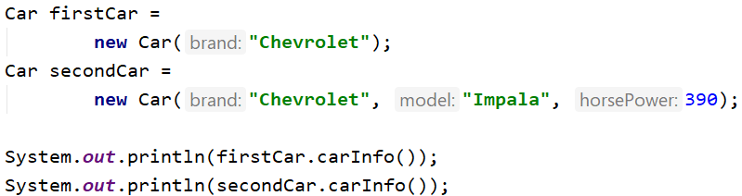
Problem: Constructors
Create a class Car
Car
-brand:String
-model:String
-horsePower:int
+Car(String brand)
+Car(String brand, String model, int horsePower)
+carInfo():String
Check your solution here: https://judge.softuni.bg/Contests/1517/Defining-Classes-Lab

Slide 33
Solution: Constructors
public Car(String brand) {
this.brand = brand;
this.model = "unknown";
this.horsePower = -1;
}
public Car(String brand, String model, int horsePower) {
this(brand);
this.model = model;
this.horsePower = horsePower;
}
Check your solution here: https://judge.softuni.bg/Contests/1517/Defining-Classes-Lab

Slide 34

Static Members

Slide 35
Static Members
Access static members through the class name
Static members are shared class-wide
You don't need an instance
class Program {
public static void main(String[] args) {
BankAccount.setInterestRate(2.2);
}
}
Sets the rate for all bank accounts
35

Slide 36
Static Members
class BankAccount {
private static int accountsCount;
private static double interestRate;
public BankAccount() {
accountsCount++;
}
public static void setInterestRate(double rate) {
interestRate = rate;
}
}

Slide 37
Problem: Bank Account
BankAccount
Create a class BankAccount
Support commands:
Create
Deposit {ID} {Amount}
SetInterest {Interest}
GetInterest {ID} {Years}
End
-id:int (starts from 1)
-balance:double
-interestRate:double (default: 0.02)
underline == static
+setInterest(double interest):void
+getId():int
+getInterest(int years):double
+deposit(double amount):void
Create
Deposit 1 20
GetInterest 1 10
End
Account ID1 Created
Deposited 20 to ID1
4.00
(20 * 0.02) * 10

Slide 38
Solution: Bank Account
public class BankAccount {
private final static double DEFAULT_INTEREST = 0.02;
private static double rate = DEFAULT_INTEREST;
private static int bankAccountsCount;
private int id;
private double balance;
// continue…
Check your solution here: https://judge.softuni.bg/Contests/1517/Defining-Classes-Lab

Slide 39
Solution: Bank Account (2)
public BankAccount() {
this.id = ++bankAccountsCount;
}
public static void setInterest(double interest) {
rate = interest;
}
// TODO: int getId()
// TODO: double getInterest(int years)
// TODO: void deposit(double amount)
// TODO: override toString()
}
Check your solution here: https://judge.softuni.bg/Contests/1517/Defining-Classes-Lab

Slide 40
Solution: Bank Account (2)
HashMap<Integer, BankAccount> bankAccounts = new HashMap<>();
while (!command.equals("End")) {
//TODO: Get command args
switch (cmdType) {
case "Create": // TODO
case "Deposit": // TODO
case "SetInterest": // TODO
case "GetInterest": // TODO
}
//TODO: Read command
}
Check your solution here: https://judge.softuni.bg/Contests/1517/Defining-Classes-Lab

Slide 41

Summary
…
…
…
Classes define specific structure for objects
Objects are particular instances of a class
Classes define fields, methods, constructors and other members
Constructors are invoked when creating new class instances
Constructors initialize the object's initial state

Slide 42
Questions?
Notes:
42

Slide 43











SoftUni Diamond Partners

Slide 44



Educational Partners

Slide 45
Trainings @ Software University (SoftUni)
Software University – High-Quality Education, Profession and Job for Software Developers
softuni.bg
Software University Foundation
softuni.foundation
Software University @ Facebook
facebook.com/SoftwareUniversity
Software University Forums
forum.softuni.bg
45
Notes:
45

Slide 46

License
This course (slides, examples, demos, exercises, homework, documents, videos and other assets) is copyrighted content
Unauthorized copy, reproduction or use is illegal
© SoftUni – https://about.softuni.bg
© Software University – https://softuni.bg
Notes:
46

